Slide 1


Main Changes to CanadaGAP Food Safety Manuals
(Version 11.0) 2026

Slide 2
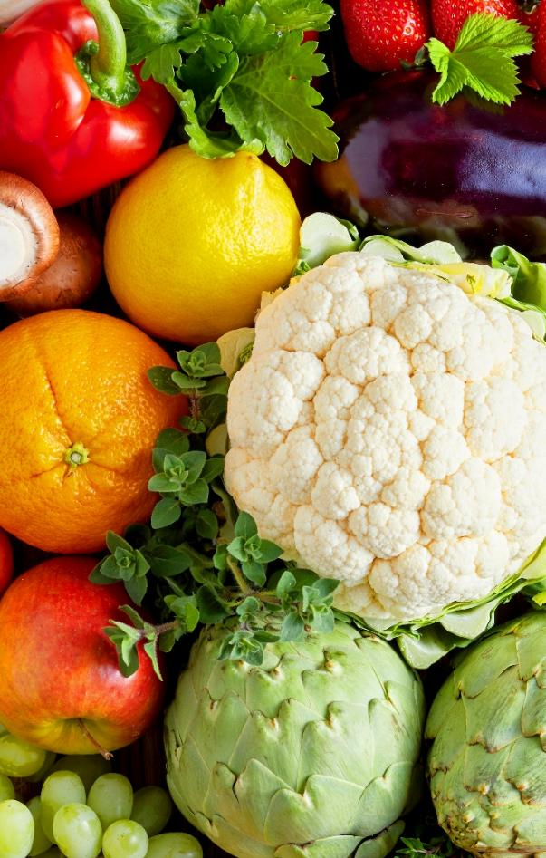
Presentation Overview
Release of CanadaGAP Manuals for 2026
Main changes to CanadaGAP Manuals (Version 11.0)
Updates to CanadaGAP Record-Keeping Templates (Forms)
Main changes to CanadaGAP Appendices (Version 11.0)
Q&A

Slide 3
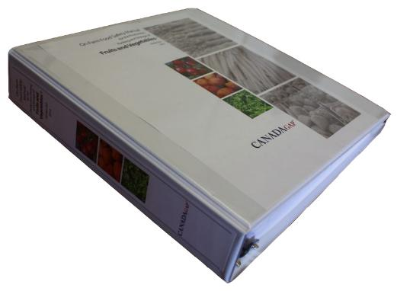
Release of CanadaGAP Manuals for 2026
Manuals are published in January
Changes are for the 2026 season
  The updated manuals take effect April 1st 2026, which gives operations
  time to update their manuals, implement changes, and retrain as needed.
  Audits on or after April 1st 2026 will be based on the updated requirements.
Notes:
A separate communique from CanadaGAP provides users of the manuals with suggestions and guidance on updating their manual.

Slide 4
Main changes to the Manuals
Version 11.0
New manuals are published on the CanadaGAP website at: www.canadagap.ca
  Background
  Scope
  How Do I Use This Manual?
  Glossary definitions
  Sections 1-24
  Record-Keeping Forms
  Appendices

Slide 5
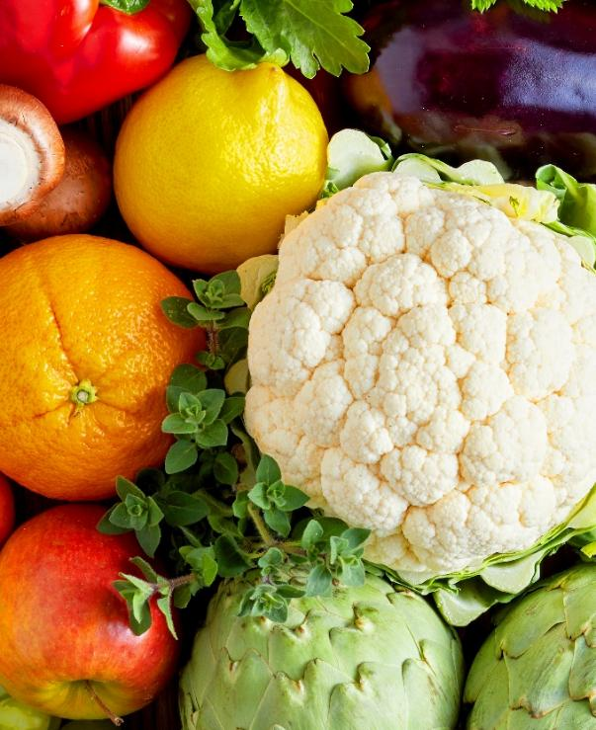
Background
The following sentence (in red) was added to satisfy a GFSI requirement (the intent remains the same):
The CanadaGAP Food Safety Manual for Fresh Fruits and Vegetables has been developed based on a Generic Food Safety Hazard Analysis and Critical Control Points (HACCP) Model. There shall be commitment from senior management for implementation of the aforementioned effective HACCP system…

Slide 6

Scope
1) The following wording was added to clarify that minimally processed products are NOT included in the production, packing and storage scopes:
Minimally processed fruits and vegetables (see glossary definition) are NOT included in the production/packing/storage scope.
2) Ground cherries and tomatillos have always been included in the scope of the program but are now specifically listed so it is clear they are different commodities, and that they both fall under the ‘fruiting vegetable’ crop grouping.

Slide 7
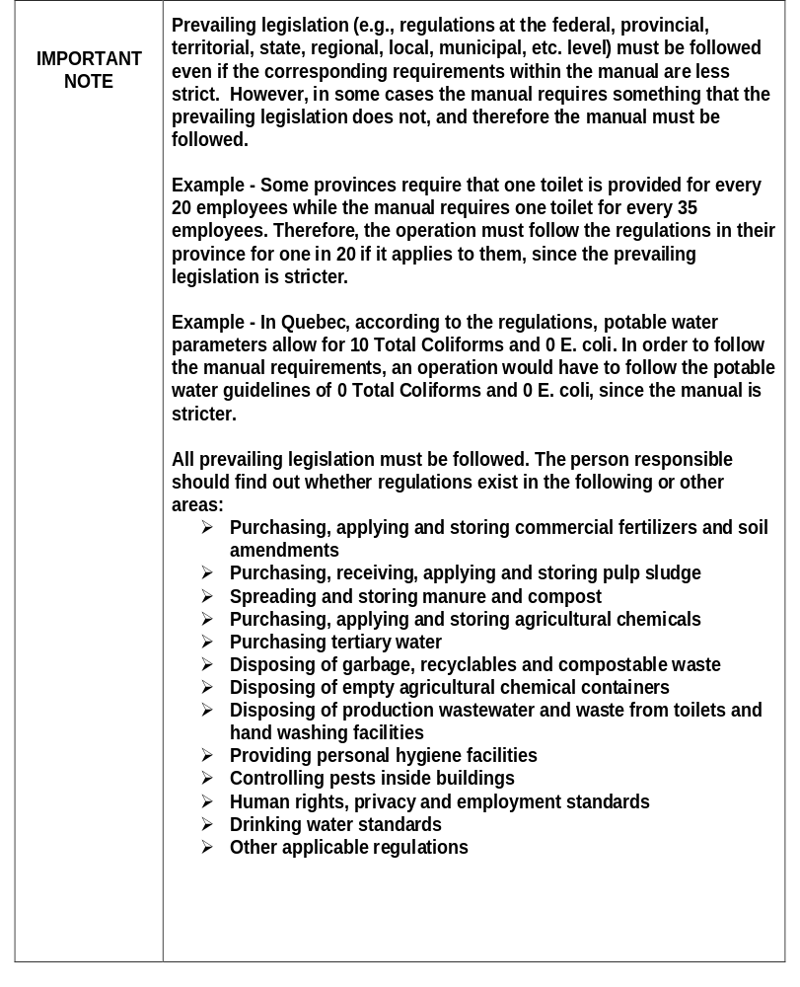
How Do I USE This Manual?
The important note regarding prevailing legislation has been reorganized and some additional wording has been added for clarification and to ensure the intent is clear.

Slide 8

Glossary – new Definitions
Laundered: Cleaned in a way that ensures the items (e.g., working effects such as gloves/aprons, cloths used for wiping product, etc.) will not contaminate product, packaging materials, etc. This cleaning must be under the operation’s control (such as sending it to a third-party laundry service, laundering items on-site, outsourcing the cleaning to an appropriate person, etc.)
Lubrication water: Water used for the lubrication of product (e.g., potatoes) before packing. This water may be a fine spray/mist.
Notes:
Definitions were revised for clarity and to account for changes in the manuals.

Slide 9
Glossary – revised definitions
Final rinse water: Water used in the final step of the cleaning process that covers all surfaces of the product (i.e., high volume spray/shower that drenches the entire product). If water is used for lubrication of product (e.g., potatoes) before packing, either after the final rinse or without a final rinse, this water is also considered here, although it may be a fine spray/mist.
Market product: Produce that is in market ready packaging materials. It may be packed in the production site or packed/repacked in the packinghouse. This would also include produce ready for market, but that is not sold/distributed in market ready packaging materials (e.g., bundled leeks on pallets going to food service, retail, customer, repacking, etc.)

Slide 10
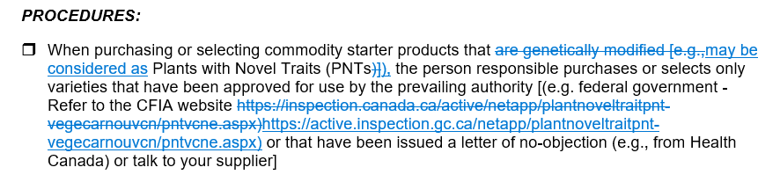
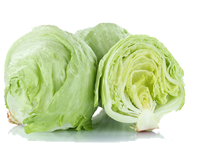
Section 1 – Commodity Starter Products
Terminology changed
Notes:
Terminology needed to be changed, because the terms ‘Plants with Novel Traits” and ‘Genetically Modified’ cannot be used interchangeably. The terminology now mirrors that which is used by CFIA.

Slide 11

Section 2 – Premises
Deletion of the following text (in red) regarding the production site assessment for clarity:
Annually [prior to using the production site (regardless of whether it’s first time use or not)] – The person responsible conducts an assessment of ALL production sites…

Slide 12
Section 2 – Premises
Section 2.2
The following requirement was removed since there are no food safety related building codes that would be applicable:
❒ The person responsible ensures that any new buildings or modifications/ renovations to existing buildings meet applicable (e.g., federal, provincial, state, local, etc.) building codes with respect to food safety

Slide 13
Section 2 – Premises
GREENHOUSE Manual ONLY
  2.1 Production Site and Surroundings Assessment, Cleaning, Maintenance, Repair and Inspection
If product is grown in a tray/bag/trough/pond/etc. using a growing medium (e.g., rockwool, sawdust, vermiculite, soil, peat, etc.), and not directly in the ground, the person responsible receives a letter of assurance from suppliers of that growing medium after purchasing/selecting it (one letter per supplier per season) (File under Tab: Letters of Assurance/Certificates)
Notes:
A frequency was added to the requirement for greenhouse operations to receive a letter of assurance for their growing medium (one letter per supplier per season).

Slide 14
Section 8 – Equipment
Additional text was added (for both production site equipment and building equipment) for clarity
Section 8.2
•Cloths used for wiping product are:
❒ clean (new or laundered daily by the operation) and replaced on a daily basis

Slide 15

Section 14 – Pest Program for production sites and buildings GREENHOUSE Manual ONLY
A missing reference to production sites was added for Greenhouse operations, since this requirement applies to production sites as well
Section 14.1
• The person responsible uses traps in production sites and buildings and ensures that: …
❒ If using bait inside production sites and buildings, it is in a trap from which rodents cannot escape (e.g., tin cat, iron cat, ketch-all)

Slide 16
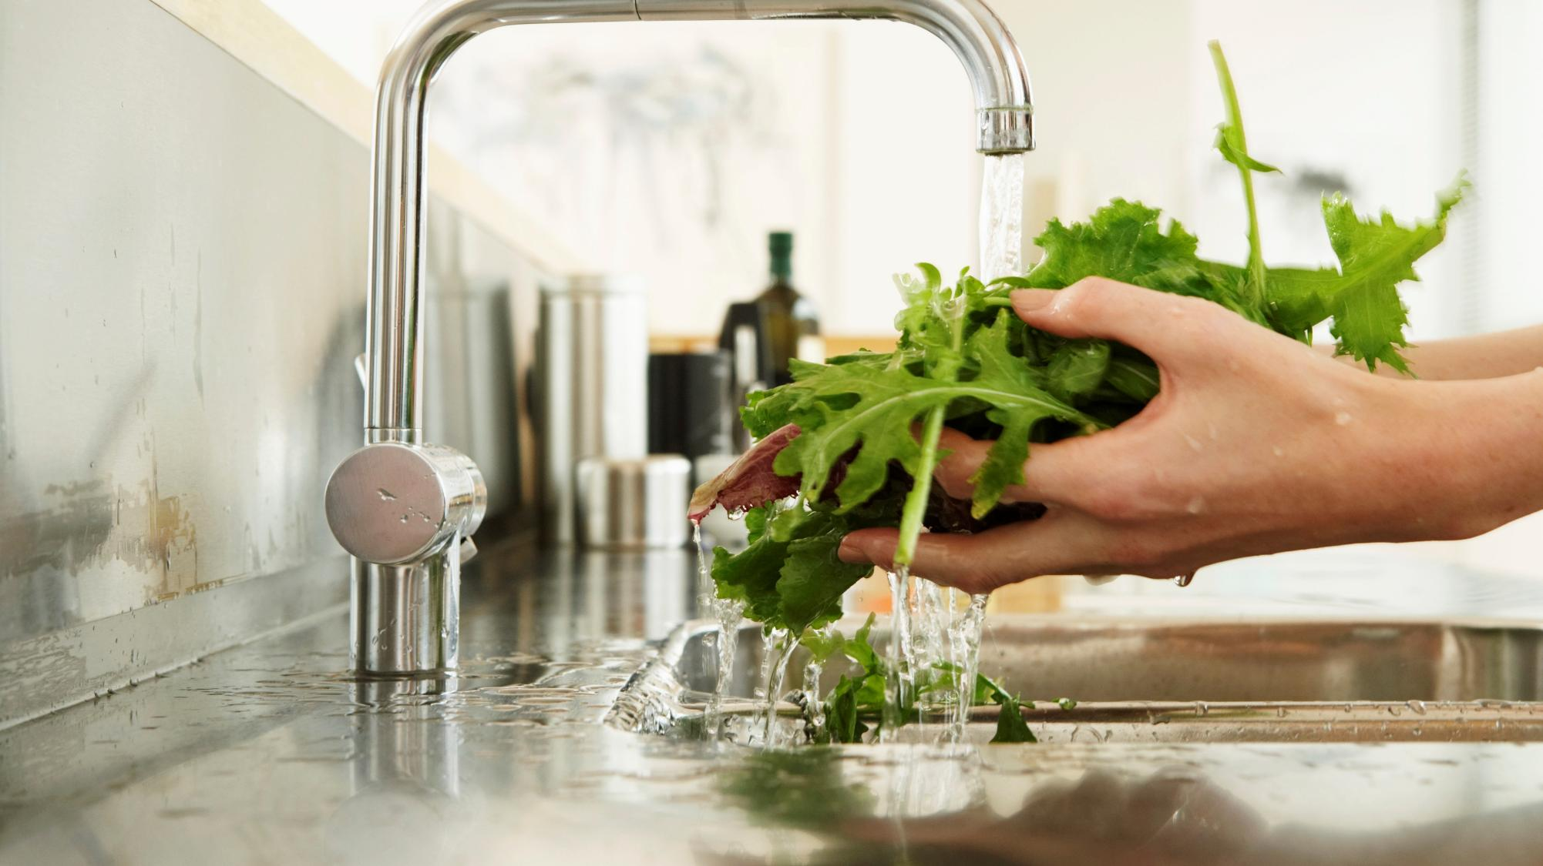
Section 15 – Water (for Fluming and Cleaning)
F&V Manual ONLY
New requirements were added for:
- water for lubrication
- water used for the application of wax
Added to ensure potential hazards from these practices are mitigated.

Slide 17
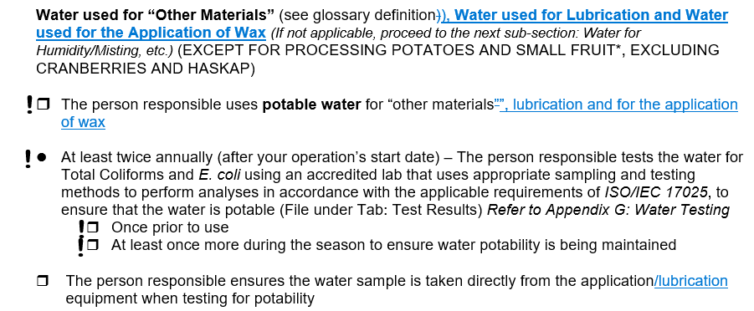
Section 15 – Water (for Fluming and Cleaning)

Slide 18

Section 17 – Packaging Materials
A change was made to outline that Section 17 – Packaging Materials DOES apply to wholesaling operations but only for packaging accessories.
Beginning of the section states:
(FOR WHOLESALING – ONLY ‘Packaging Accessories’ sub-sections apply)

Slide 19
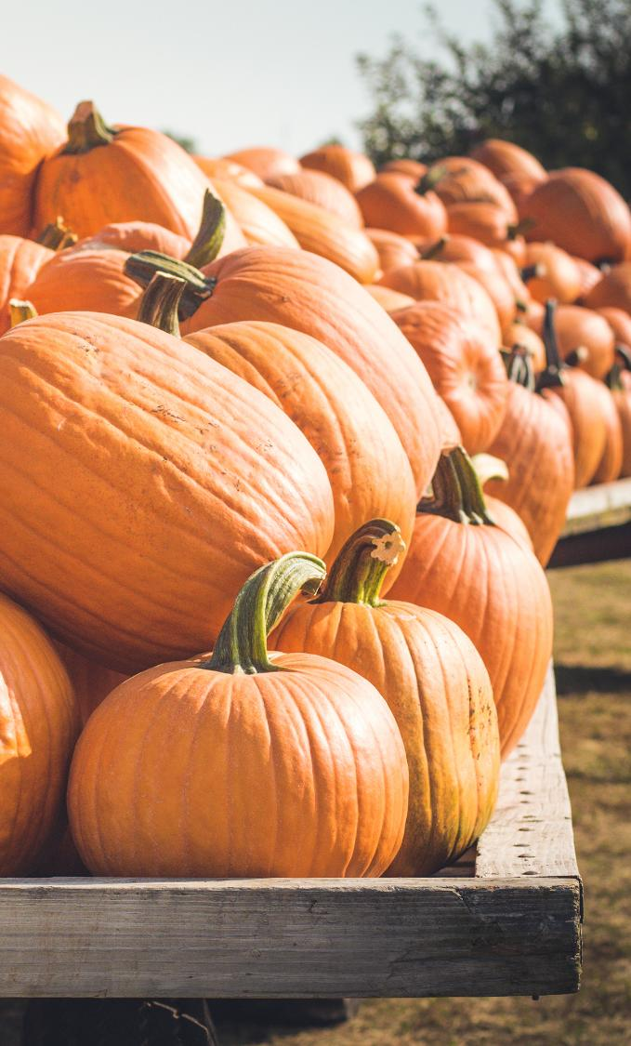
Section 17 –
Packaging Materials
Pumpkins are now exempt from the following requirement:
• The person responsible uses materials that are:
❒ Are kept off the ground (e.g., placed on a cardboard slipsheet/pallet liner that is not a source of contamination) whether in the field or on platforms, stairs and catwalks where employees walk, etc. (except for pumpkins)

Slide 20
Section 20 – temperature Conditioning/Holding/Storage of Product
To ensure that it was clear that each section/sub-section included requirements for temperature conditioning and holding these were added to the titles
Section 20. Temperature Conditioning/Holding/Storage of Product
Sub-section 20.1 Temperature Conditioning/Holding/Storage Conditions
for Harvested Product (including bulk)
Sub-section20.2 Temperature Conditioning/Holding/Storage Conditions
for Market Product

Slide 21

Section 21 – Transportation
The sub-section titles as well as the wording within the sub-sections was adjusted to focus on what type of product is being transported (i.e., harvested product, market product) instead of the type of packaging material.
• 21.1 Transportation of Product in Harvested Product Packaging Materials (including bulk product)
• 21.2 Transportation of Market Product in Market Ready Packaging Materials

Slide 22

Section 23 – Deviations and Crisis Management
Mock Recall – Section 23.3
Wording was added to ensure it was clear that the requirement applies to the operation’s entire traceability system.
❒ Annually (current season’s product) – The person responsible conducts a mock recall to test the effectiveness of the operation’s entire traceability system by completing the forms

Slide 23
Section 23 – Deviations and Crisis Management
Section 23.8 Food Safety Culture
The following were added to align with an update to the GFSI requirements:
Requirement:
Commitment must be made to maintain a strong food safety culture within the operation through communication, training, feedback and performance measurement. Senior management must commit to establishing direction, engaging personnel, and providing sufficient resources to maintain a positive food safety culture.
Procedures:
• The person responsible creates, assesses, implements and maintains food safety culture by:…
❒ Making a long-term commitment to sustaining and improving food safety, including providing sufficient resources

Slide 24

Updates to CanadaGAP
Record-Keeping Forms for 2026

Slide 25

CanadaGAP Forms
FORM C
Additional requirements added to mitigate possible risks associated with jewellery and other personal effects in the production site.
These requirements are the same as those found in Form D.

Slide 26
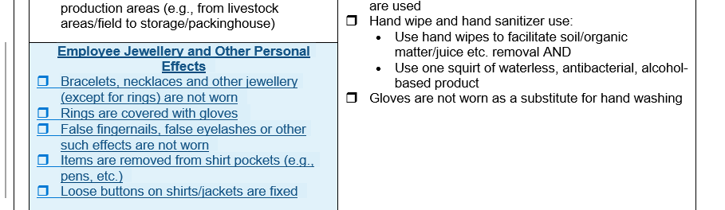
Form C

Slide 27


Main Changes to CanadaGAP
Appendices for 2026

Slide 28
Changes to Appendices
Appendix Q:
  List of MRL databases updated for several countries based on feedback received by program users and availability of databases.

Slide 29
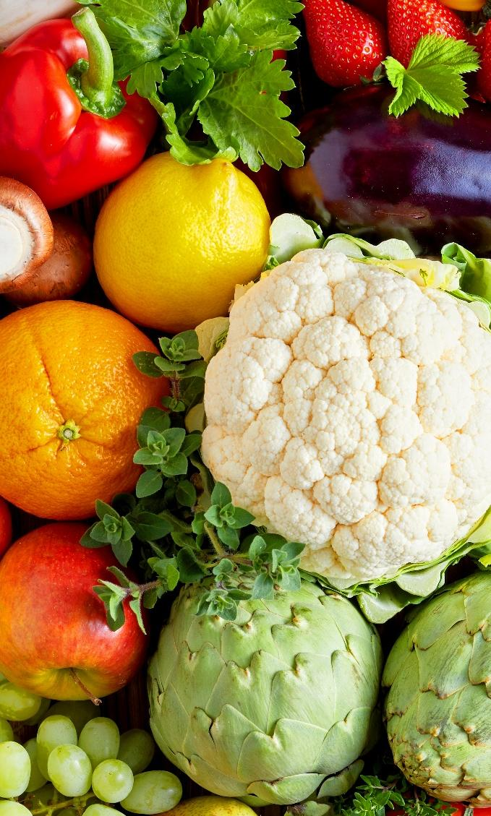
Questions?
CanadaGAP Program
245 Menten Place, Suite 312
Ottawa, Ontario, Canada
K2H 9E8
Tel: 613-829-4711
Fax: 613-829-9379
Email: info@canadagap.ca
Web: www.canadagap.ca

