Slide 1

Town Hall 2026
August 24, 2026
Florenceville, New Brunswick

Slide 2

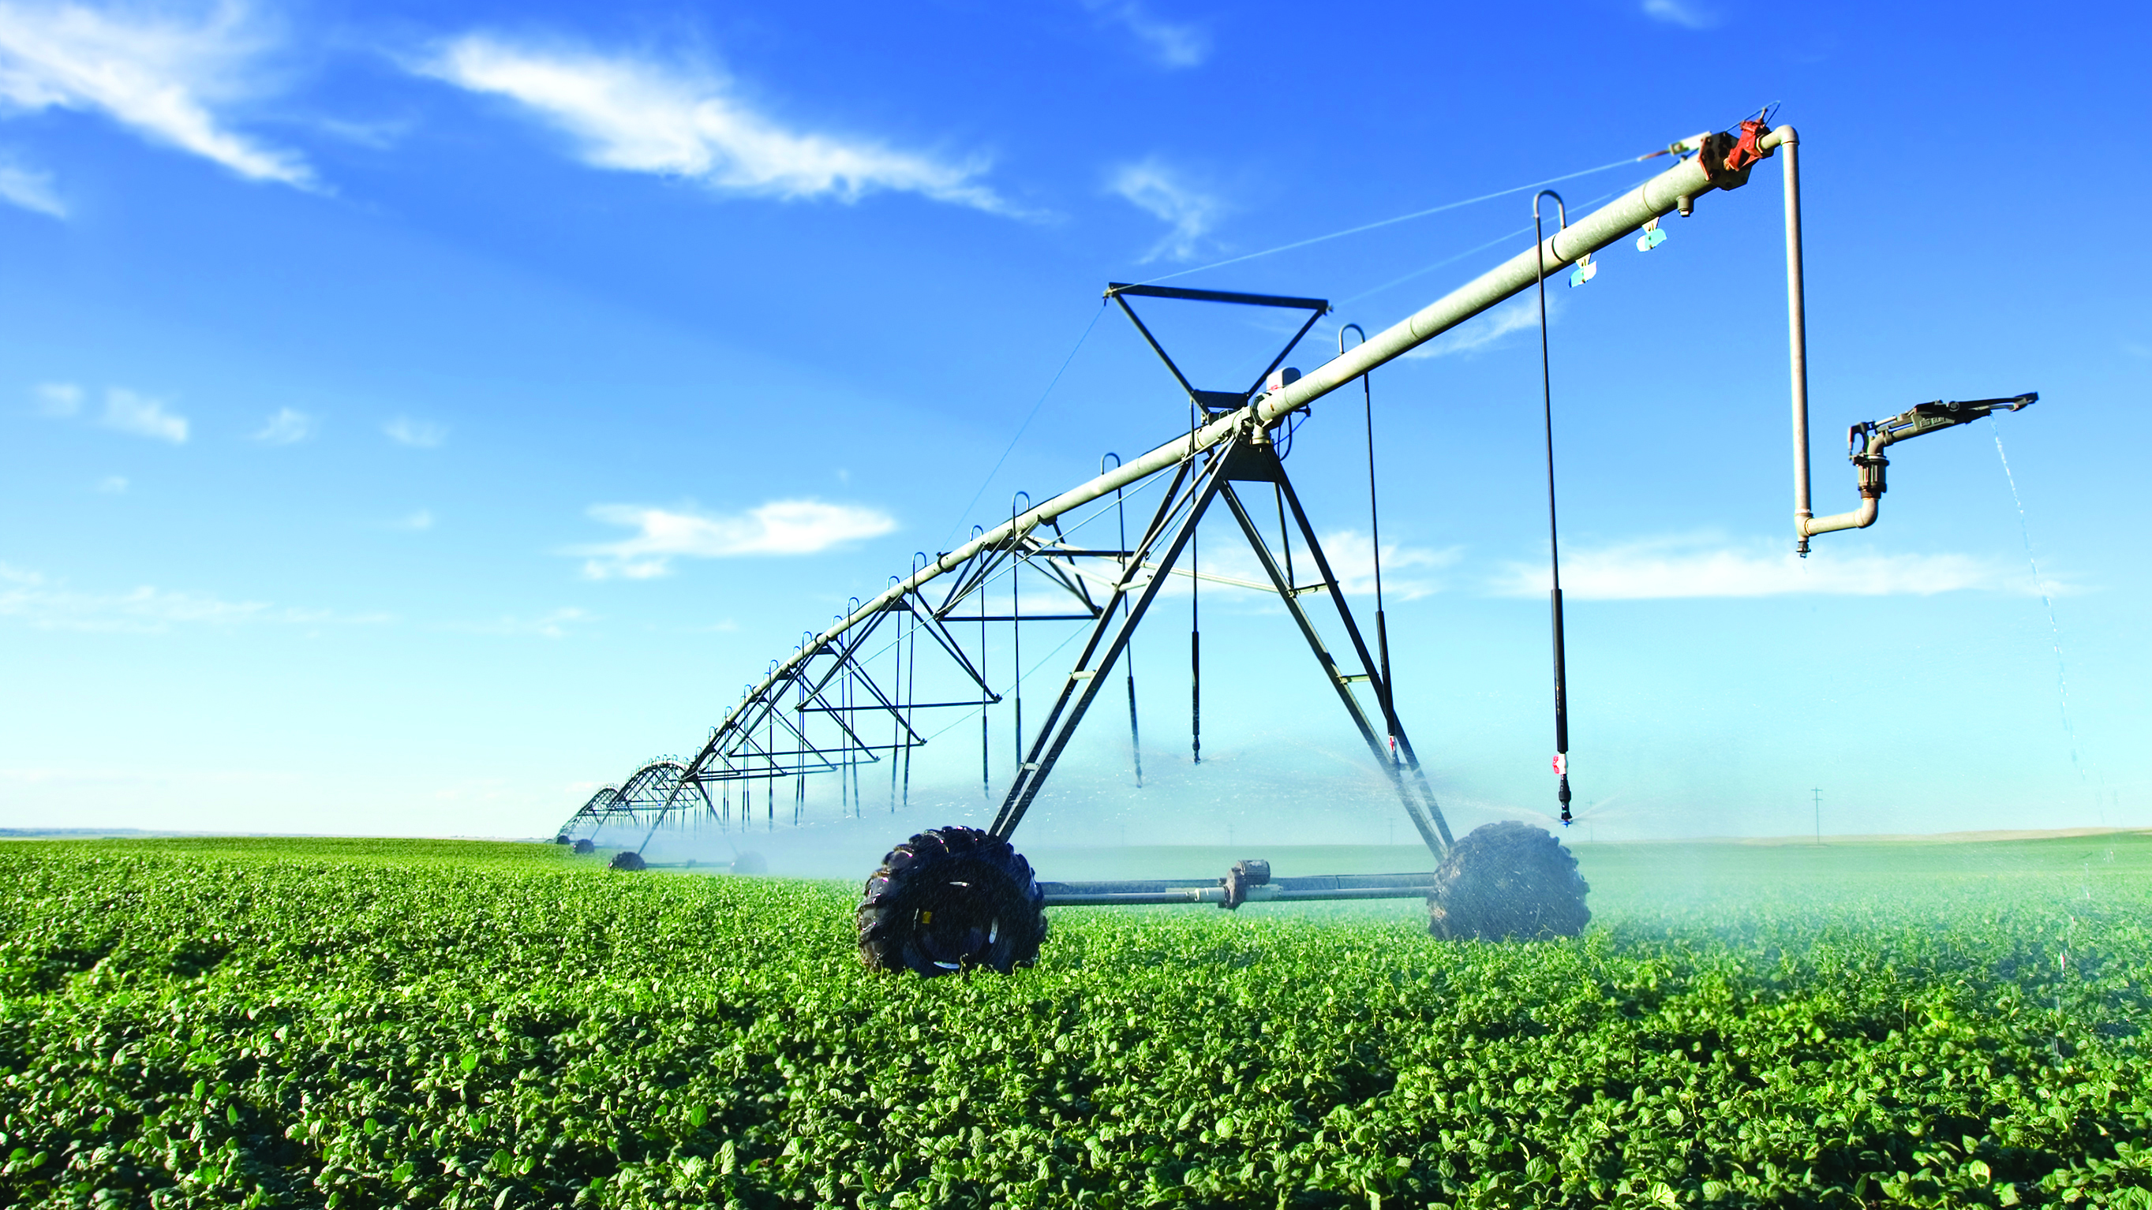
SESSION Overview
Welcome
Background Information on CanadaGAP
The Role of Recognition
Partially remote audit for processing potato growers
Participant Questions
Join us for Lunch!

Slide 3
WELCOME
Thank you for taking part in this session, and for your warm hospitality!
We’re pleased to welcome a number of different stakeholders
  Program participants
  Representatives from Potatoes New Brunswick
  CanAgPlus Board of Directors
  CanadaGAP staff members
  We’re expecting a few other guests for lunch

Slide 4
CanadaGAP’s
History, Mandate and Role

Slide 5
RESPONSIVE TO GROWERS
The program’s original mandate was given to CanadaGAP by growers
CanadaGAP began in 2000 as the On-Farm Food Safety (OFFS) Program developed by the Canadian Horticultural Council (CHC), now the Fruit and Vegetable Growers of Canada (FVGC)
Members voted on the direction and mandate that CanadaGAP has in place today
CanadaGAP is now independent of the FVGC, but we still work every day to deliver on the direction set by industry
  Our entire structure, business plan, budget and allocation of resources is based on that original mandate
Program scope: all of horticulture in Canada, all types of suppliers
Notes:
CanadaGAP is designed for a whole range of horticultural products. The certification program encompasses more than150 different kinds of fruit and vegetable crops grown in Canada. The manuals were developed to be used by many different kinds of operations:
farms of all types
packing operations -- on-farm and off-farm, field packing, packing sheds, large standalone packinghouses, etc.
operators of storage facilities (both on-farm and standalone)
wholesale businesses
repacking facilities
brokerages

Slide 6

CANADAGAP’s Mandate
HACCP-Based
Technical requirements reviewed by government (federal and provincial) and deemed technically sound
Government-recognized and aligned with regulations
Accepted by customers
Delivered at lowest possible cost to growers
Notes:
In a few minutes I’m going to elaborate further on of these components of CanadaGAP’s mandate, but specifically talking about 3 and 4.
As program users, you want or need these things, but you don’t always like what they entail. Sometimes we don’t, either!

Slide 7
HACCP-BASED and Technically Sound
CanadaGAP has done a separate, specific hazard analyses for all commodity groups, including potatoes
The practices in the manuals that apply to potato growers correspond to identified hazards in the Potato HACCP Model
The HACCP model has been reviewed numerous times over the years and deemed technically sound by federal and provincial government representatives
  That means experts agree that every identified hazard is a potential hazard for potatoes and needs a corresponding control measure
  That’s where the procedures in the manual come from – they are the agreed-upon measures deemed to control each hazard
  Based on sound food safety science
Notes:
The Potato HACCP Model was developed in consultation with a team from industry (growers, packers, processors) to understand fully the practices and risks involved.

Slide 8
HACCP-BASED and Technically Sound
CanadaGAP must ensure that not only the commodity-specific HACCP models, but also the CanadaGAP Food Safety Manuals are reviewed and approved by government
For Potatoes, the reviewers included representatives from CFIA and other federal government departments (Health Canada, PRD [formerly PMRA], AAFC) and provincial government reps from PEI, NB, ON, QC, MB, AB, BC
The manuals are provided as a comprehensive template of all the potential procedures and records that a company would need to include in their documentation to operate a complete food safety program
Not everything in the manual may be applicable to a given user of the CanadaGAP program (e.g., not only different crops, but different activities)
Notes:
By its very nature, because it is designed to serve a wide range of operations, the manual requires the user to review the material and apply the elements that are relevant to their crop(s) and activities.

Slide 9

POTATO PROGRAM REQUIREMENTS
CanadaGAP does NOT require potato farmers to have the same food safety practices as leafy greens growers (or other high-risk crops)
There are differences throughout the CanadaGAP Food Safety Manuals relative to procedures that must be followed by potato growers, vs. procedures that must be followed by leafy greens growers or producers of other crops with a different risk profile
Potatoes have many exemptions in the manual that don’t apply to other crops (see one-page handout for examples)
Notes:
[Yes, there is also some overlap in commodity-specific requirements, but that is because the same hazards were found across a number of crop groupings.]
PNB has invested in engaging a consultant to make a ‘potato-specific’ manual for its growers, removing other requirements that wouldn’t apply. This needs to be maintained – i.e., reviewed and updated annually if CanadaGAP publishes corrections or changes to the base manual.

Slide 10
The role of recognition
Canadian Government Recogntion
Acceptance from Buyers
GFSI Recognition

Slide 11
GOVERNMENT RECOGNITION
In 2017, after thirteen years of technical and administrative reviews, the CanadaGAP program achieved full Government Recognition for all of the technical components, the management system, and delivery of the certification program
A challenging and arduous process, dating back to 2004 with initial rejection of the original Generic HACCP Model for Potatoes
Recognition is favourably viewed by retailers and processors who require their customers to be CanadaGAP-certified
To maintain recognition, CanadaGAP remains under ongoing CFIA oversight, including:
  Annual review of the HACCP models and manuals is required
  20-month ‘maintenance of recognition’ reviews
  CFIA must approve every change CanadaGAP proposes to make, whether to technical requirements for program users or certification program rules
Notes:
The technical review process under the Canadian Government Food Safety Recognition Program determined that the generic HACCP model for Potatoes is technically sound, that the identified hazards are relevant to the industry, and that the associated control measures in the manuals are effective. The Potato HACCP Model is reviewed and updated regularly to reflect any changes in science or regulations.

Slide 12
COMPLIANCE WITH REGULATIONS
Government Recognition also means that CanadaGAP requirements must be consistent with all applicable regulations, federal, provincial and territorial
When the Safe Food for Canadians Regulations (SFCR) were published, CanadaGAP had to demonstrate that program requirements are fully aligned with the new regulations
Independent of our usual Government Recognition, CFIA undertook a separate review of CanadaGAP technical requirements to compare them to new regulatory provisions
  After another lengthy review process (2017-2018), CFIA determined that CanadaGAP requirements matched new regulatory requirements for food safety
This exercise was repeated again in 2019
  Result: CanadaGAP has to add more requirements to the 2020 manuals to align completely with the SFCR (e.g., Lot code for traceability)
Bottom line: CanadaGAP must align with all applicable regulatory requirements to maintain Government Recognition

Slide 13
HOW PRODUCERS BENEFIT from CANADAGAP’s GOVERNMENT RECOGNITION
Government Recognition is a direct benefit to Canadian growers using the CanadaGAP program because:
  It allows producers to satisfy the demands of Canadian customers
  It enables producers to meet federal regulatory requirements if product is being sold outside of the province
  It may reduce the frequency and/or intensity of CFIA inspections at certified operations
  Access to CanadaGAP Generic HACCP model if a full preventive control plan is required by the inspector
  The alignment of CanadaGAP with the Safe Food for Canadians Regulations means that companies who export to the U.S. do not need to meet any additional U.S. Food Safety Modernization Act (FSMA) requirements. Meeting CanadaGAP requirements means producers are meeting the applicable regulations in Canada, and are therefore not subject to further U.S. regulations.

Slide 14

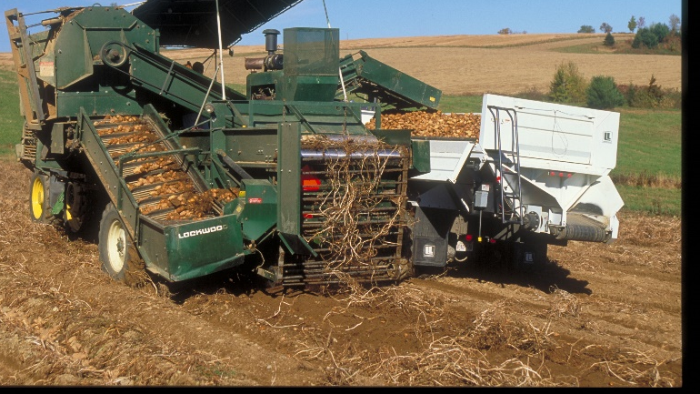
ACCEPTED BY
CUSTOMERS
Notes:
Fourth element of the mandate we were given.
CanadaGAP is not worth all the paper it’s written on, if certification is not accepted by your customers. Our commitment to members in all sectors of the horticulture industry is to continue to be a viable program that will be accepted by customers.

Slide 15
CUSTOMER EXPECTATIONS
CanadaGAP was developed out of a demand from industry for a coherent, national
food safety program that was government-recognized and acceptable to all customers
  In the late 1990s, different customers had begun to mandate different food safety programs, which often led to multiple audits, contradictory standards, etc.
  No one wants to do more than one food safety program or audit
Buyers made clear from the beginning (1997) that if industry (through CHC) were to develop a national food safety program with grower input, they would support the effort, on condition that the technical requirements of the program underwent government technical review and received CFIA and provincial/territorial government approval
This would demonstrate that the program was credible and rigorous, and it became the basis for acceptance of CanadaGAP by customers (processors and retailers)
Notes:
We have heard it said that customers would not require food safety certification if programs like CanadaGAP did not exist.
That is exactly backwards.
Getting customers to accept a program requires years of tireless effort and education; it is not a project to be undertaken lightly.

Slide 16
GLOBAL FOOD SAFETY INITIATIVE
GFSI is the Global Food Safety Initiative
  It is an international benchmarking scheme that allows recognized programs like CanadaGAP to be accepted by buyers internationally
Many customers (retailers and food service, and increasingly manufacturers) now ask their suppliers to be certified against a GFSI-recognized program
Some customers may not understand what all of the GFSI requirements are, but they still want a GFSI-level certification
Other customers know very well what GFSI requires, and some think even that may not be enough and may have additional customer-specific requirements
That is the reality facing programs like CanadaGAP and others

Slide 17
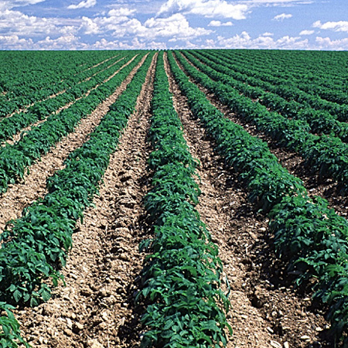
GROWING DEMANDS AND EXPECTATIONS
To maintain recognition, CanadaGAP has been required to add elements to the
program as GFSI introduces new requirements
  That’s where requirements for food safety culture, food fraud, food defense,
  unannounced audits, and environmental monitoring came from
CanadaGAP participates in many GFSI working groups and makes great efforts
to sensitize customers to the realities of farming and the implications on farmers
of additional food safety requirements
Unfortunately, we are a small fish in a big pond, and our best arguments may never prevail over the demands of Walmart, Nestlé, General Mills and many other major food industry players at the GFSI table
We do not have a choice if we want to maintain international recognition

Slide 18
BENEFITS OF GFSI RECOGNITION
Because CanadaGAP is GFSI-recognized, the program is accepted by international customers
Many suppliers to food service buyers such as McDonalds, Sysco, etc. have been required to get GFSI-recognized certification, such as CanadaGAP (Option C) or GLOBALG.A.P.
Processing customers like McCain Foods Canada have been content to accept the four-year audit cycle (Option A1) offered by CanadaGAP because the rest of the program (technical requirements) is benchmarked to GFSI
  The upshot of processors accepting the four-year audit cycle is that potato growers have had fewer audits than most CanadaGAP-certified companies, who are audited annually
Notes:
Many CanadaGAP-certified growers in NB have had three audits in the last decade or more. Perhaps the growers don’t realize it, but that is a considerably less than most of the industry!
Even if the processing potato industry doesn’t need GFSI recognition, after all the support for government technical review and recognition from McCain Foods and other customers, it would be surprising if processors would accept a program that is less than the one deemed technically sound by CFIA.
Government Recognition has also enhanced our position with GFSI, in terms of underlining the science and technical basis of CanadaGAP requirements.

Slide 19
A DIFFICULT BALANCING ACT
CanadaGAP sometimes feels that we are straddling a divide:
  In meetings with growers, CanadaGAP is called upon to explain the outside forces that require the program to add requirements that are unpopular with producers
  In meetings with CFIA and GFSI, CanadaGAP is facing escalating and sometimes unrealistic demands that customers or government may be placing on producers
When we have no choice but to add certain requirements, we carefully consider how to make them as do-able as possible for program participants

Slide 20
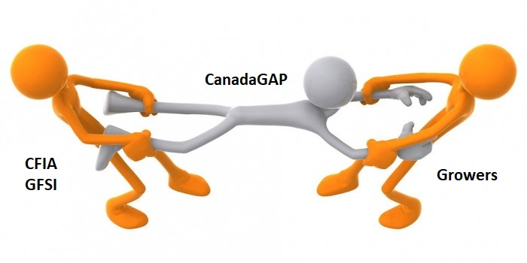
Notes:
We are constantly being pulled in opposite directions:
We do what we have to do (what is expected or demanded by customer expectations, regulatory requirements, or other outside forces) while trying to ensure practicality for program users. We’re always aware that growers need tools, prescriptive procedures and templates for record-keeping that will help them implement and meet program requirements.

Slide 21

How CanadaGAP is different from OTHER FOOD SAFETY PROGRAMS
CanadaGAP is one of several GFSI-recognized food safety programs
accepted by customers
Other options for farms include SQF, PrimusGFS, or GLOBALG.A.P.
  Each of those programs requires an annual audit
  SQF would also require each farm to have a site-specific HACCP Plan
  PrimusGFS requires an audit of every field
  Not only will other program’s audits take longer, but the overall cost to the farm will likely be higher than CanadaGAP because of the annual audit frequency
All food safety programs take work (reading, maintenance and upkeep) throughout the year

Slide 22
Differences FROM OTHER PROGRAMS
Other key differences:
  Resources available to producers to help them understand how to implement and meet program requirements
  The way the standard is written (clearer audit expectations)
No other program provides a comprehensive template of procedures (the CanadaGAP manuals) and record-keeping forms for users
Other standards are typically written in a more vague, general fashion, so that the desired outcome is stated,
but no clear description of how, when or who
The grower usually has to provide their own risk assessment, written procedures and validation for their approach, which could be challenged by the auditor
CanadaGAP provides all of those details in the manual (checkboxes for procedures, risk assessment checklists or forms, guidance for SSOPs, etc.) and auditors are specifically trained on these items
All of this contributes to better consistency across CanadaGAP audits, auditors and certification bodies.
Notes:
CanadaGAP is the most prescriptive of the GFSI-recognized programs (i.e., the most “black and white” in terms of audit expectations)
Other programs have requirements that are quite vague and leave a lot open to auditor discretion (e.g., SQF)
Example of a high level requirement: “Water quality must be adequate for the intended purpose”. There may be little additional information about assessing risk for various uses, let alone when water needs to be tested, where to take the sample from, what results the grower is looking for, how to record information around water source assessment, etc.
What will the auditor be looking for, exactly?
The amount of content in the CanadaGAP manuals may be seen as a curse by growers – but it also reduces room for auditor discretion as to what might be considered “adequate for the intended purpose”.
Auditor consistency is an ongoing issue for ALL food safety programs – but CanadaGAP auditors are probably better calibrated because of the level of detail and guidance contained in the manuals and audit checklist.
Nothing is stopping growers from trying another program if they think it will fit their needs better.

Slide 23
CanadaGAP mandate
Most program users rely on CanadaGAP maintaining government and GFSI recognition for access to markets
It has not been easy to establish credibility, rigour and transparency for the program with CFIA, provincial and territorial governments, or buyers (domestic and international)
Growers will probably always want an easier food safety program
  We understand that farmers have a critical and difficult job: to produce food
  The burden that comes with that job is to provide your customers with assurance of food safety. That is the current reality.
  CanadaGAP wants to help you achieve that so that if anything happens, you can demonstrate you have done your due diligence and taken all possible measures to prevent contamination of your product.

Slide 24
Split Audits
CanadaGAP has been asked in the past to allow ‘split audits’ to occur
A ‘split’ audit is when the audit takes place over two or more on-site visits that are separated in time (e.g., an auditor comes to the farm for half an hour to observe harvesting of potatoes in October, and then returns in January to complete the document review)
CanadaGAP audits must not be split into two or more separate visits separated in time except under highly unusual circumstances, and only when the Certification Body has received written authorization from CanadaGAP to split the audit
  Permission must be sought in writing by the Certification Body, along with a clear description of the circumstances, and approval must be obtained from CanadaGAP in advance of the audit
Notes:
CanadaGAP has provided an explanation to program participants as to why it is not possible to split audits. A detailed FAQ is also available on the CanadaGAP website.

Slide 25
CANADAGAP DOES NOT ALLOW SPLIT AUDITS
Except in very special circumstances, audits must occur when activities relevant to the operation’s certification are underway – during harvest, product handling, packing/repacking season, shipping, etc.
This is important for the auditor to properly assess the implementation of the food safety program based on a snapshot of what is occurring at the operation on the day of the audit
CanadaGAP certification bodies are required to see all activities in a given operation’s scope to ensure that safe food production and handling processes are being met.
Based on risks and the observations of how these risks are addressed during audits, the Certification Body will be able to plan upcoming audits to ensure that an adequate sampling of activities is seen for each operation in future years.
Notes:
For more information, see Section 3.3.5.4 of the CanadaGAP Program Management Manual.

Slide 26
REASONS NOT TO SPLIT AUDITS
The auditor cannot assess the implementation of the food safety program properly without cross-checking details to determine their accuracy, currency and validity. Having the audit take place on two separate dates, makes cross-referencing of information next to impossible.
A two-part audit would entail substantial overlap for each visit. This means that the auditor would spend more time overall, thus increasing the total audit duration (and cost).
The tour portion of the audit may take the most amount of time for the auditor to complete; therefore, splitting the audit does not save the operation much time.

Slide 27
REASONS NOT TO Split audits (continued)
If audits were to be split, it would create confusion for the auditors about which questions to score and at which audit, especially for non-conformities. This confusion would lead to inconsistency among audits and increased potential for disputes around audit findings and results.
Splitting audits introduces a further complication for certification bodies in managing the audit and certification process for all clients.
When the operation wants to split an audit so that the auditor can rush through observing activities such as harvesting and then come back at much later date to review documents when the operation is less busy, that does not achieve the intent of an audit.

Slide 28
REASONS NOT TO Split audits (continued)
If there are non-conformances found at either of the visits, the CB and the operation may have difficulties with CAR completion, and in most cases corrective action cannot be taken after the season is over. Examples of possible situations include:
  At the 1st visit the auditor observes the agricultural chemical storage and records a few of the chemicals seen. During the 2nd visit the auditor reviews Form H1 and notices that one of the agricultural chemicals observed at the 1st visit was used on a crop that it is not registered for. An autofail would be issued, however harvested product would have already been shipped several weeks before.
  At the 1st visit handwashing facilities were observed to be fully stocked. During the 2nd visit it is determined that Form J was not completed. Since there was no record for the handwashing facility to ensure it was fully stocked throughout the season, it is unclear if the handwashing facility was being properly maintained.

Slide 29
NOT ‘split audits’ – examples:
In contrast, these examples would NOT be a split audit:
an operation needs two audits their first year in order to have two crops on their certificate— one in May for asparagus and one in October for apples.
an auditor is unable to see a new packing line on the day of an audit due to mechanical failure. The remainder of the audit is completed that day, but then the auditor returns to the operation two days later to complete the observation of the packing line.
an auditor arrives at the audit and it’s raining; therefore, the harvesting of strawberries cannot be observed. The remainder of the audit is completed that day, but the auditor returns to the operation the week after to complete the observation of harvesting.
the Certification Body has approved, in advance, a partially remote audit at a small, potato-only operation enrolled in certification option A1, where the producer/person responsible for the operation must operate the harvester on the day of the audit. The auditor completes part of the audit on-site, and the remaining portion of the audit remotely and in accordance with the requirements specified in CanadaGAP Technical Procedure TP-09-RM.

Slide 30

New: Partially Remote Audits

Slide 31
TP-09-RM – Use of REMOTE AUDITING METHODS
During the COVID-19 pandemic, CanadaGAP created a policy regarding remote or partially remote audits (TP-09-RM).
Following concerns raised by Potatoes New Brunswick, CanadaGAP made modifications to that procedure to allow for some small potato operations to undergo a partially remote audit, if conditions are met.
June 2026: This change was communicated directly to potato operations who could be affected, as well as to grower associations who represent affected farms.

Slide 32
PARTIALLY REMOTE AUDITS
This approach provides an alternative to regular full on-site CanadaGAP audits.
Part of the audit is done on-site, while part of it is completed using remote methods.
The key benefit of using remote methods relates to reducing the amount of time that the auditor must spend on-site to complete the full audit.
Components:
  Partial On-site Audit (observations, interviews, assessment of select documentation)
  Partial Remote Audit (cross-referencing information gathered on-site to the operation’s documentation and records reviewed off-site)
  “Follow-up” activities (if needed)

Slide 33
Guiding Principles
While a program participant may request a partially remote audit, it is always up to the Certification Body (CB) to make the determination as to whether an audit can be completed in part using remote methods.
To be eligible for an audit that uses remote methods, clients will have to demonstrate to the Certification Body their ability to meet the Information and Communication Technology (ICT) requirements.
  These ICT requirements are extensively detailed in the document itself; we will not go through them all today.
A full on-site audit remains the preferred approach for CanadaGAP audits.

Slide 34
WHICH Potato operations are eligible?
When the producer has exceptional circumstances to justify requesting the CB to use partially remote auditing methods, and the Certification Body has validated those circumstances.
Such circumstances may include, for potatoes only:
  small farms enrolled in a non-GFSI recognized certification option (i.e., CanadaGAP Option A1, A2, or E);
  where the producer/person responsible for the operation must operate the harvester on the day of the audit and therefore has limited availability to participate in the audit while the auditor is on-site.
  Note: potato producers who also have other commodities included in the scope of their certification are not eligible for partially remote audits.
Notes:
In addition, other operations that are eligible:
-Brokerage operations are eligible for a fully (100%) remote audit.
-When the site cannot be physically accessed by an auditor and the audit cannot be delayed to a later date because the client has a short seasonal window in which the audit must occur for the Certification Body to observe relevant crops/activities.
-When the site cannot be physically accessed by an auditor and the client has no other crops/activities that the Certification Body could observe at a later time.

Slide 35
Restrictions
Cut-off Date to Request a Partially Remote Audit: The program participant must request an audit using partially remote methods by contacting their Certification Body at least 30 days in advance of the planned audit timeframe. Under no circumstances will the Certification Body and/or auditor accommodate a client request for a partially remote audit once the auditor has arrived on-site.
  Note: in 2027, this timeframe will be increased to 3 months advance notice for all requests.
Unannounced Audits may be conducted using partially remote methods. However, in such instances, the program participant must request that partially remote auditing methods be used at the time that the client is first informed by their Certification Body that they have been selected for an unannounced audit (i.e., beginning of the season).

Slide 36
COST implications
It is understood that program participants who opt for a partially remote audit can expect to incur additional costs
Additional costs associated with services delivered by the Certification Body are determined solely at the CB’s discretion
These extra costs reflect the additional administration that is required by the CB to deliver the services associated with a partially remote audit, including but not limited to document handling (e.g., transfer of documents, off-site review) and any follow-up that may be needed
By opting for a partially remote audit, the program participant agrees to pay any additional fees levied by the CB in relation to audit and certification activities

Slide 37
COST implications (CanadaGAP)
Random Audits: Additional costs will also be charged directly by CanadaGAP to Options A1 or A2 program participants selected for a random audit, who request that the CB to perform their random audit using partially remote methods
In such cases, CanadaGAP will levy a surcharge of $1,500 CAD, which is payable by the program participant upon receipt of an invoice issued directly by CanadaGAP subsequent to the CB performing the partially remote audit
The surcharge is intended to offset the additional costs that will be charged back to CanadaGAP by the Certification Body for delivery and administration of the partially remote audit

Slide 38
Process for Partially Remote audits (1)
    The process is described in detail in TP-09-RM, which is available on the CanadaGAP website at:
    https://www.canadagap.ca/faq-items/can-an-operation-request-an-audit-with-a-remote-component-which-operations-are-eligible/
    The on-site visit will occur first, before the remote review of documents
    In general, the on-site portion of the audit should take ~ 2 hours; it may take less time for smaller, simpler operations
The auditor will hold an opening meeting. If the necessary discussion points can be communicated in a different way (e.g., by email, through advance notice to clients, in the audit plan) by the Certification Body or auditor, that is also acceptable.

Slide 39
On-site portion (2)
The auditor will tour the premises, using the CanadaGAP Audit Checklist as a reference and/or to take comprehensive notes (i.e., who the auditor interviewed, what was observed, etc.).
The auditor will ensure all interviewing and conversations with employees and the food safety contact occur while on-site.
Items to check may include:
  Production site and surroundings
  Bin tag numbers, Pack IDs
  Agricultural chemical information (for chemicals in storage)
  Equipment type and condition
  Pest control trap numbers and locations
  Water sources and uses, how the fluming/washing/cooling/rinsing process is set up, water treatment methods (e.g., is the UV light on?)
  Interior and exterior of buildings (condition)
Notes:
Note that the above lists are not exhaustive. What the auditor needs to check will depend on the operation.

Slide 40
On-site portion (3)
      The auditor must ensure to check items that have no records associated with them, such as:
    First aid kits, personal effects, working effects, areas where these items are stored
    Hand washing stations and toilet facilities – employee use, auditor checking to ensure they are properly stocked and functional
    Handling of waste and wastewater
    Types and location of cleaning and maintenance materials (including relevant information from the label)
The auditor will review the CanadaGAP Food Safety Manual (spending at least 15-20 minutes)
to ensure that the manual has been completed
Notes:
Note that the above lists are not exhaustive. What the auditor needs to check will depend on the operation.

Slide 41
On-site portion (4)
      The auditor will consider whether the following records may need to be checked on-site, depending on the number of documents and/or length of the documentation:
    Internal audit checklist
    Calibration instructions and details
    Agricultural chemical receipts
    License/certificates or formal training documents for ag chemical applicators
    Documentation related to MRLs for exported products
    Certificates/audit reports from suppliers or outside service providers
The auditor will evaluate Question A4 to ensure ongoing maintenance of the program (including previous year’s documents)
The auditor will complete the Executive Summary as clearly as possible, and hold a closing meeting
Notes:
Note that the above lists are not exhaustive. What the auditor needs to check will depend on the operation.

Slide 42
Process for Partially Remote audits (5)
      Next comes the remote component, carried out after the on-site portion
      The remote component is to be initiated as soon as possible, preferably within the same week, but NO MORE THAN 4 WEEKS, or BEFORE THE END OF THE SEASON, whichever is sooner
      The auditor must get the desired records from the auditee. This could include the operation’s
    completed records (e.g., last three months of records)
    detailed procedures (SSOPs)
    the Recall program (chart from Section 23 and Appendix S)
    mock recall records
    water/ice tests
    letters of assurance
    any other suggested documents that were not reviewed during the on-site (e.g., supplier certificates)

Slide 43
Process for Partially Remote audits (6)
      The auditor uses the requested documents to cross-reference with on-site observations and interview finding as noted on the Audit Checklist or in the auditor’s notes from visiting the premises
      If an auditee does not comply with supplying the requested documents before the deadline, that would trigger another on-site visit (at the client’s expense) to complete the audit, or else certification would be suspended/withdrawn by the Certification Body
      There is a checklist available at the end of the TP-09-RM to help auditors keep track of on-site vs. remote items, which may also be helpful for auditees

Slide 44
Process for Partially Remote audits (7)
      Follow up may be required after the on-site visit. This could be carried out by phone, Zoom, etc.
        In some cases, this could include a walkaround by the auditor at the operation (with or without the auditee), or the submission of photographic evidence
      The auditor will need to document all steps thoroughly:
        All necessary follow-up will be written in the ‘Additional Comments’ section of the audit checklist
        Confirmation that all 3 steps of verification are still being used (observation, interview, documentation)
        Confirmation of ICT use
        Additional administrative steps (on-site times vs. remote review, collection of follow-up information from auditee)
      The Executive Summary will need to be updated.

Slide 45
IT’s your turn
QUESTIONS?
Are there any specific questions or comments?

Slide 46
NEXT STEPS
Thank you for your participation!
If you are interested in the partially remote audit option, and you meet the criteria discussed today, please reach out to your CB as soon as possible.
A copy of these slides will be available on the website following the meeting (both English and French)
If you have any other questions, please contact the CanadaGAP office (see next slide)
Lunch starts at 11:30 a.m. and we look forward to continuing the dialogue with you!

Slide 47
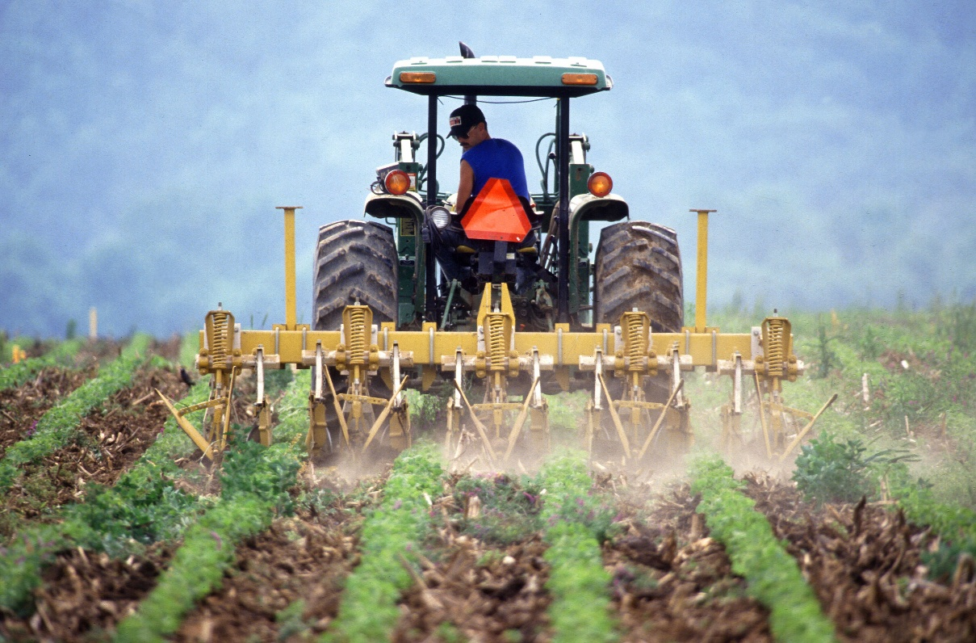
Contact Information
CanadaGAP Program
245 Menten Place, Suite 312
Ottawa, Ontario, Canada
K2H 9E8
Tel: 613-829-4711
Fax: 613-829-9379
Email: info@canadagap.ca
Web: www.canadagap.ca

